Slide 1
ECEN 403:
Active Ankle-
Foot Orthosis (AAFO)
Polina Golikova
Alfred Boss
Christopher Galik
Tyler Pierce

Slide 2
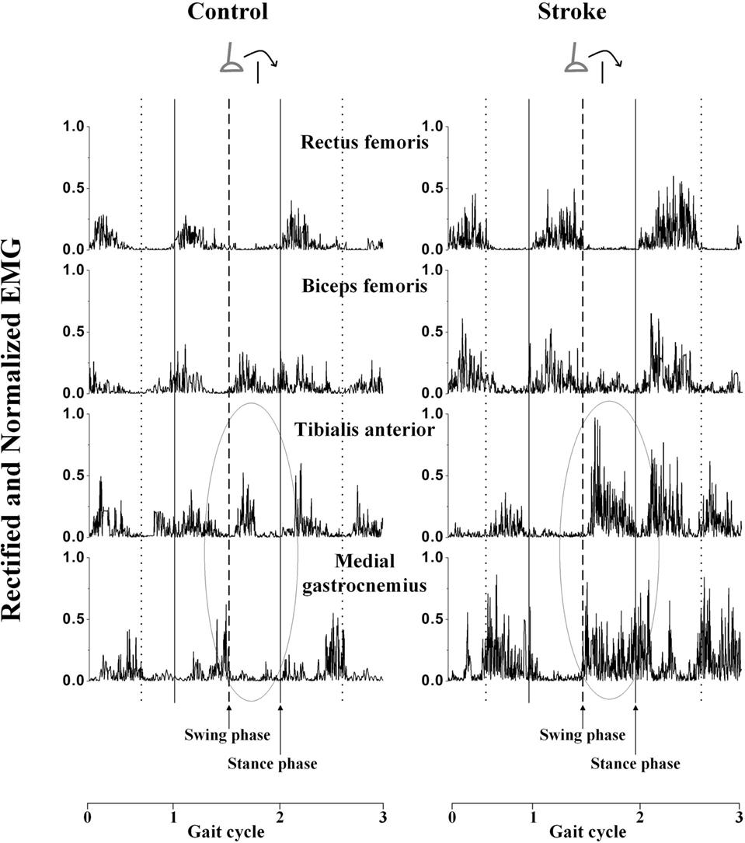
Executive Summary
Medical complications result in restricted motion control of lower leg and lack of muscular support.
AAFOs attempt to supplement that motion and support it by providing another source of power.
P.A.C.T.s AAFO will improve upon previous designs by
integrating input from muscular signals and binary control system from mechanical sensors.
Incorporating novel technology developed through research.

Slide 3
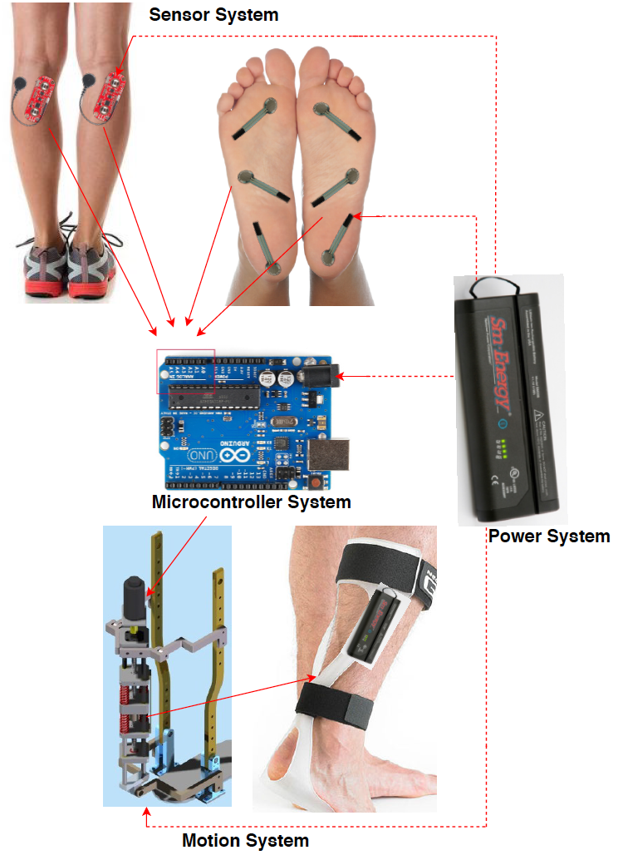
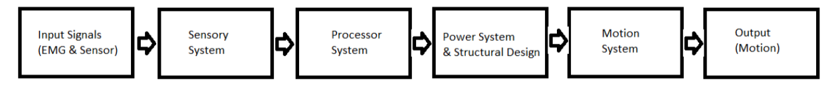
System Overview
Electrical EMG sensors and mechanical sensors will measure electrical activity and pressure in the leg and foot.
The AAFO will transport signals from the 2 sensors to the MCU.
The microcontroller will interpret signals and determine which stage of gait the user is in and supply corresponding motor control.
The motion system, which acts as an artificial muscle, will move the joint by attaching to a rigid structure.

Slide 4
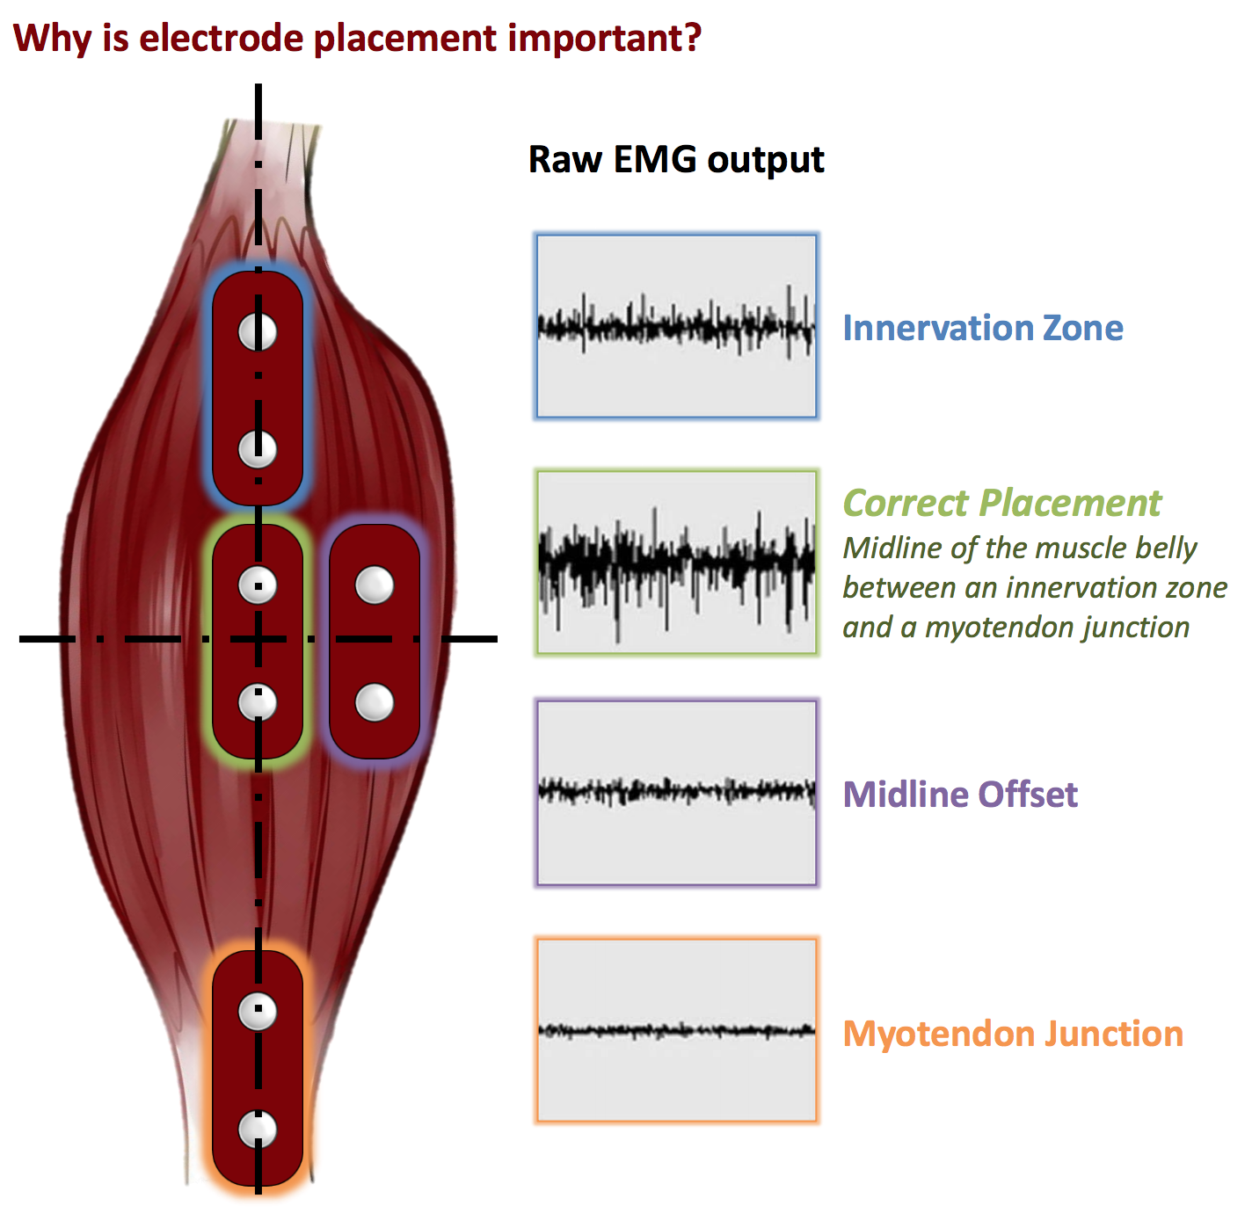
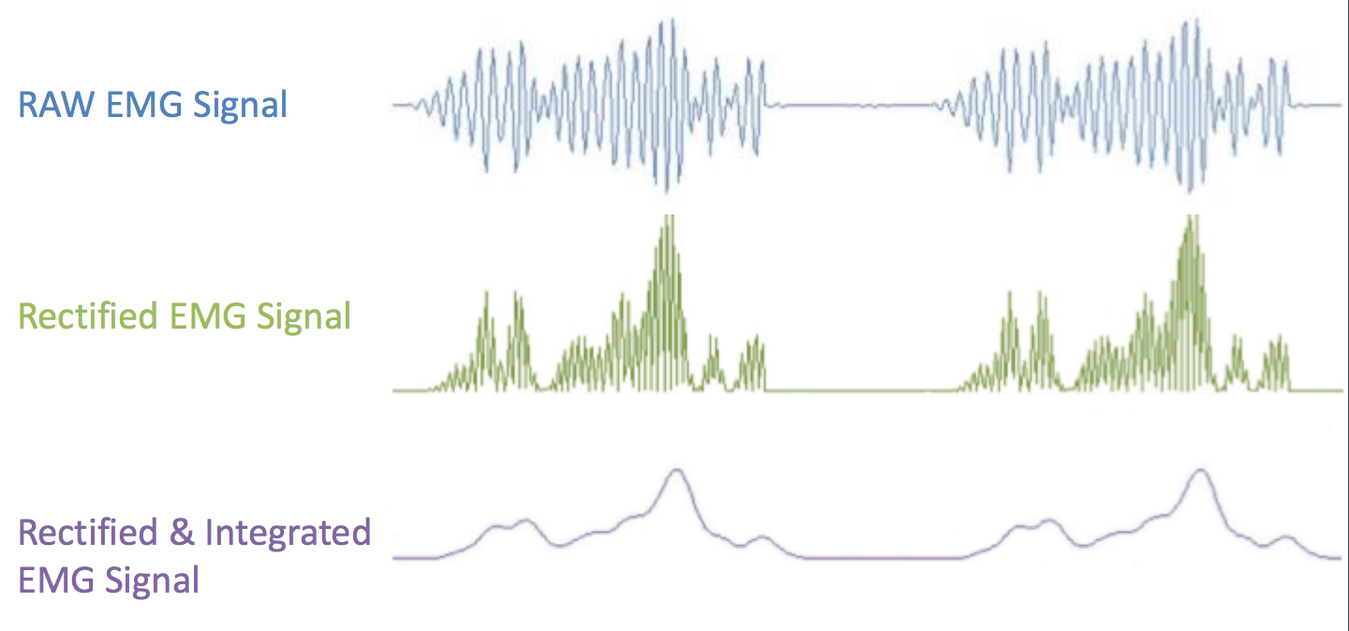
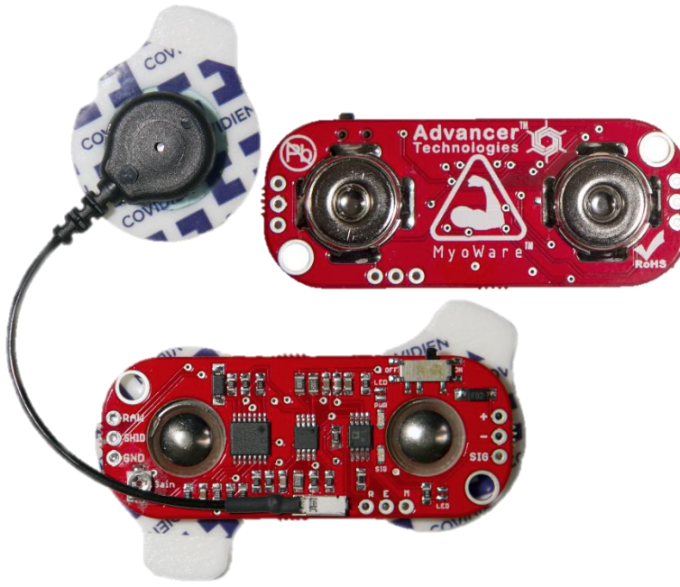
Sensor System - EMG sensor
Electromechanical delay - between 10 and 40 ms
Myoware - Active Surface EMG Sensor
Muscles - Soleus, Gastrocnemius (Calf Muscle)
Notes:
Returning to the question of gait electromyography, the tendon tap response could be likened to eccentric activation during walking . A logical conclusion to draw from these multiple studies is that the average electromechanical delay during gait is no more than 40 ms and perhaps as short as 25 ms or even 10 ms.
Signal interferance from other muscles must be considered

Slide 5
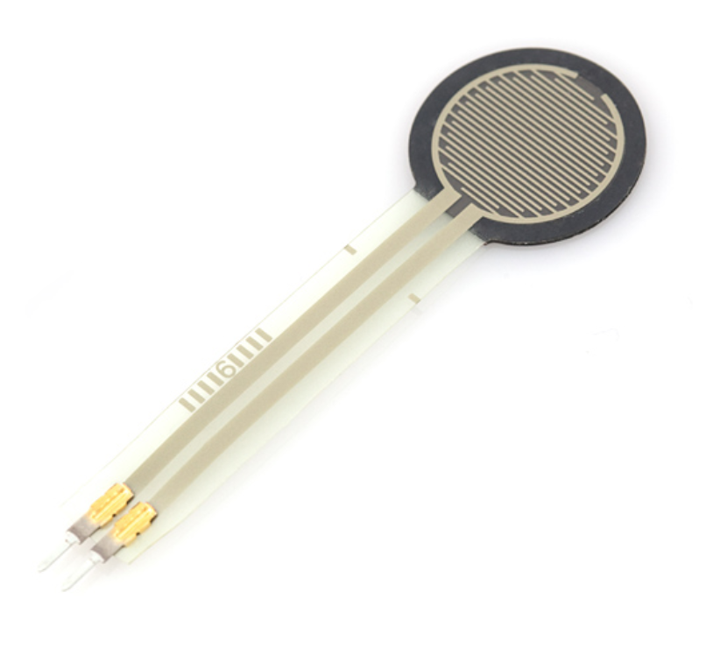
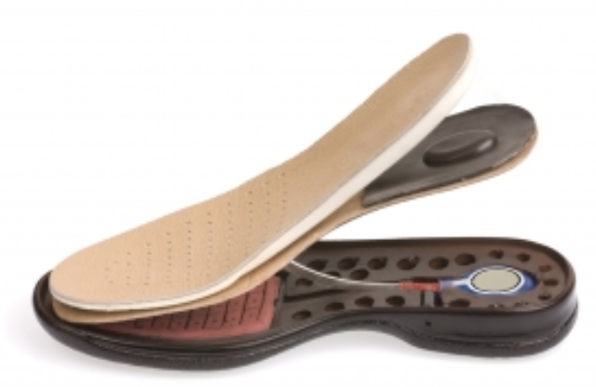
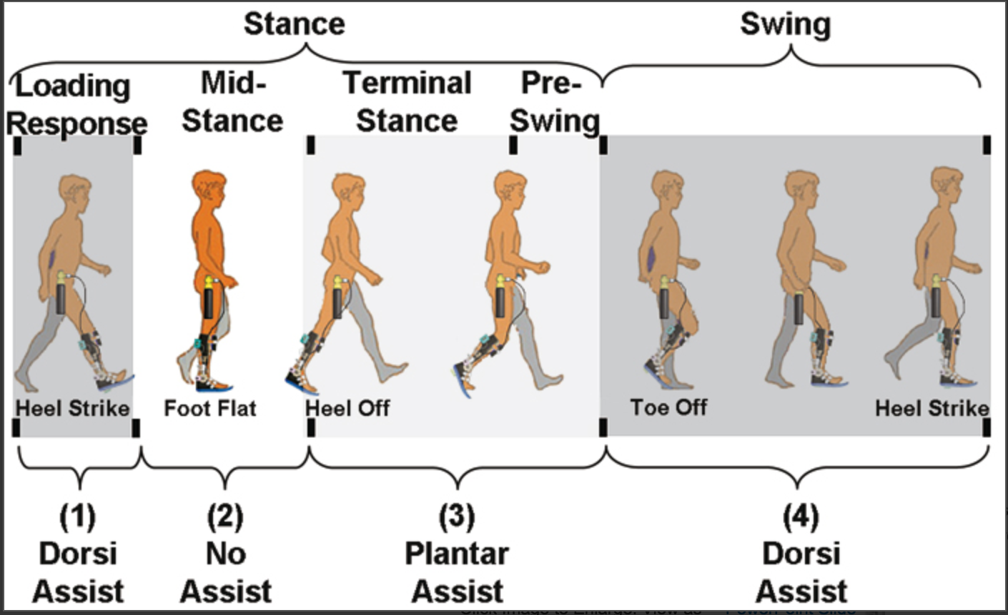
Sensor System - Pressure Sensor
Placement at Toe and Heel
Collaboration with Gait Analysis Treadmill 404 Team
Maximum Pressure: 150 psi
Force Sensing Resistors
Increase in Pressure, Decrease in Resistance
Active Sensing Area: 1.5”x1.5”

Slide 6
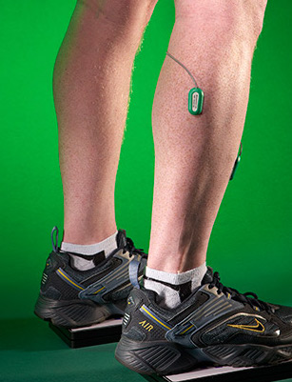
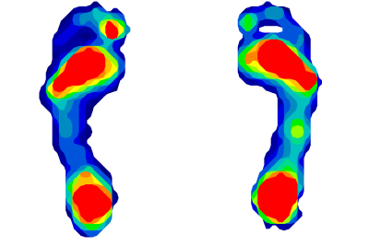
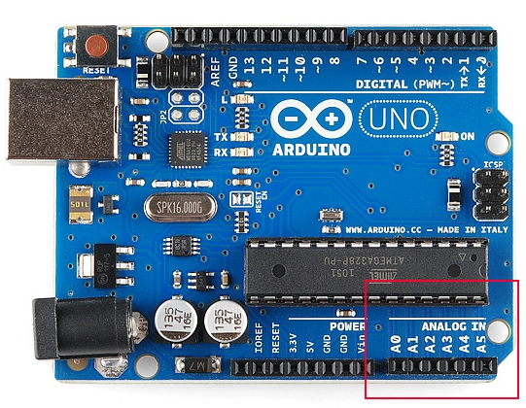
Microcontroller System
Receives electrical muscular response (V) from EMG sensors and foot mapping from force resistive sensor to ADC.

Slide 7
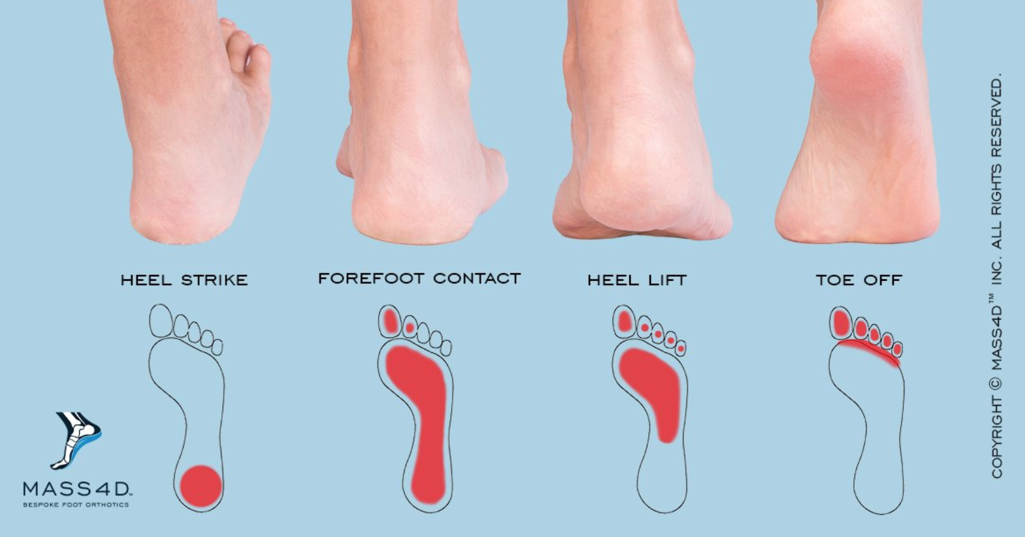
Microcontroller System
A .C program will be running on Arduino will analyze input signal for maximum voltage peaks from EMG sensors and perform gait analysis on foot pressure from foot mapping.
Enable motor by matching peak EMG voltage with corresponding foot pressure.
step up
more force, less resistance
less force, more resistance

Slide 8
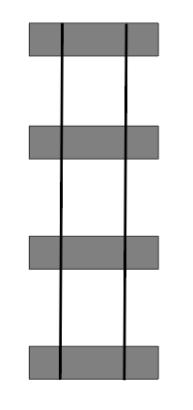
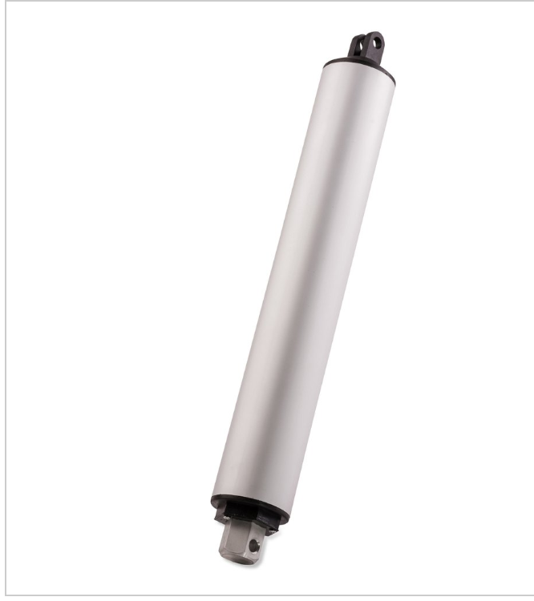
Motion/Motor System
Based upon values obtained through research, the AAFO needs to be able to support specific weight values at specific times in the gait cycle (Designed for 5’6” 150lb male)
Will incorporate multiple types of motors and novel motion technology to meet force requirements

Slide 9
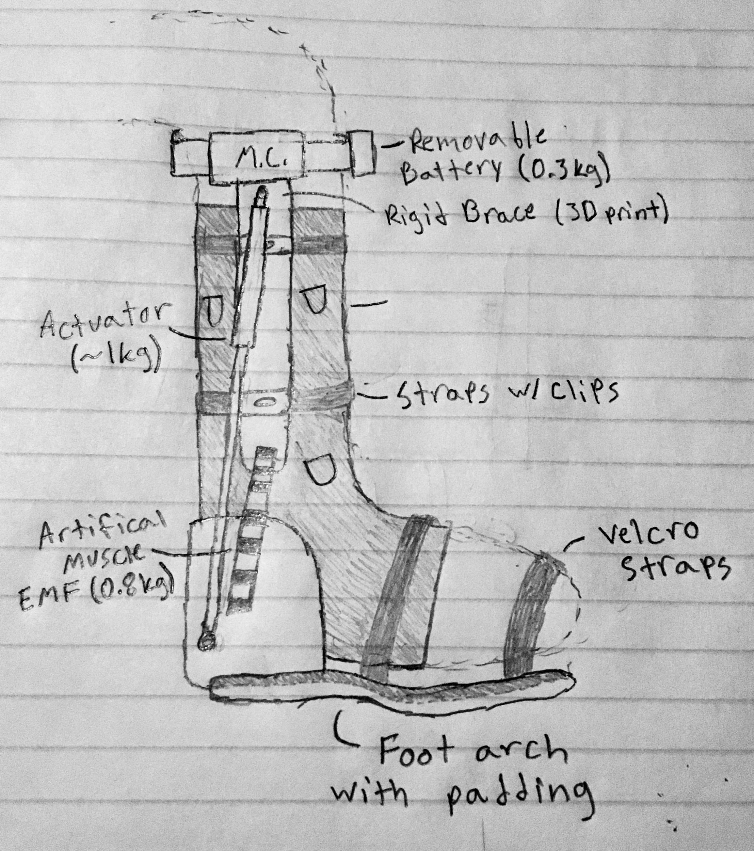
Structural Design
Provides structural support for the motor system and processor as well as the power supply.
Design Constraints
Needs to be adjustable to fit 90% of the population.
Maximum 3.5 kg (~7.7 lbs) for whole structure (motors, battery, microprocessor)
Maximum 18 in. support column length.

Slide 10
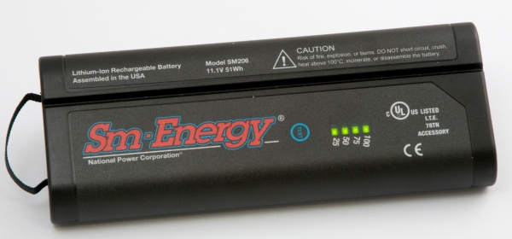
Power System
Power supply and delivery.
Design Constraints
30 Minutes to 1 Hour operation.
Maximum 4.6 Ah power consumption.
Expected 12 V input voltage.
Rechargeable and detachable battery.

Slide 11
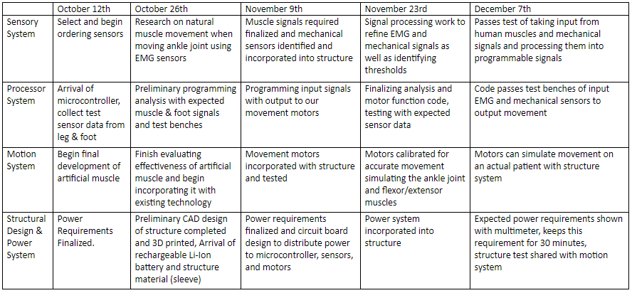
Execution and Validation

Slide 12
Questions?

